Slide 1

Cloud Development POE
Video Demonstration:
https://youtu.be/aWqusqzMH18
Rocston John Oppelt
ST10276665

Slide 2
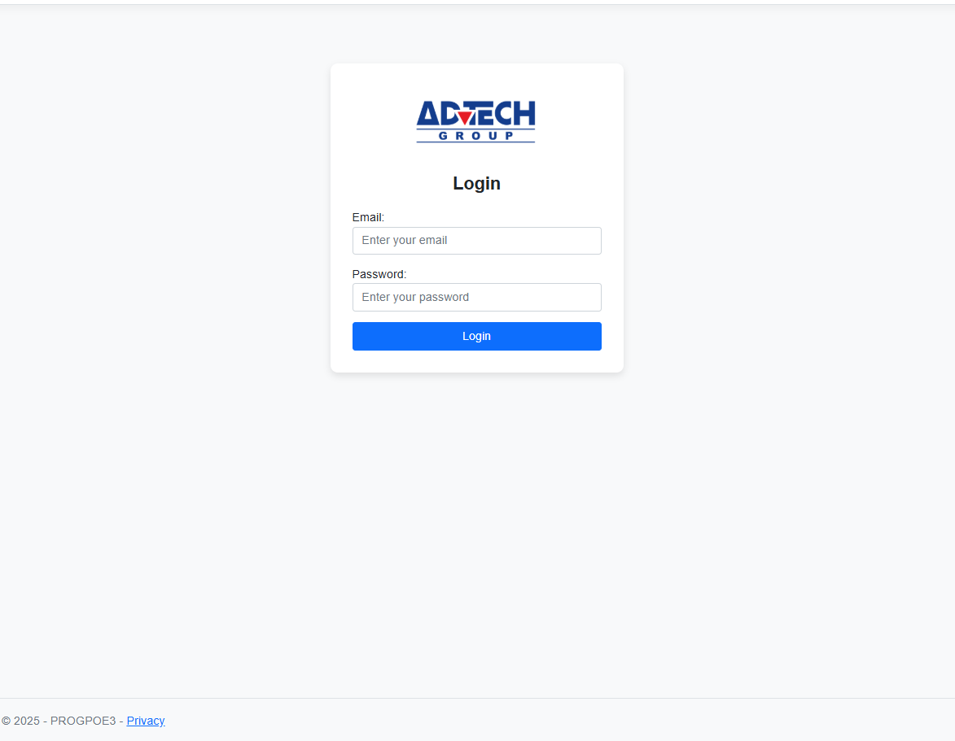
The landing page
This is the landing page of the web system. Users can log in and access the system based on their roles (Lecturer, Programme Coordinator, Academic Manager, HR). The navigation and access control are powered by a dictionary.

Slide 3
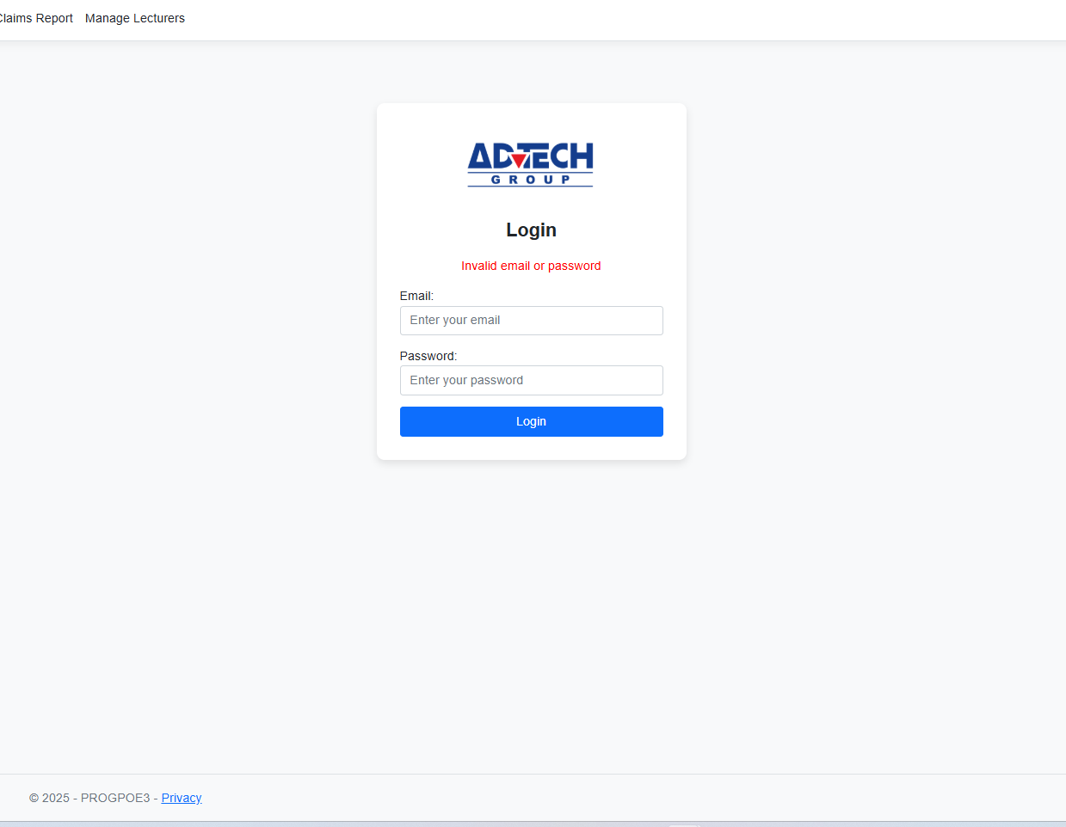
Login Validation & Error Handling
To make things smoother while keeping access safe, the system checks details automatically when logging in. If someone types the wrong email or uses a bad password, it spots the mistake right away - then shows a straightforward warning message
“Invalid Email or Password”

Slide 4
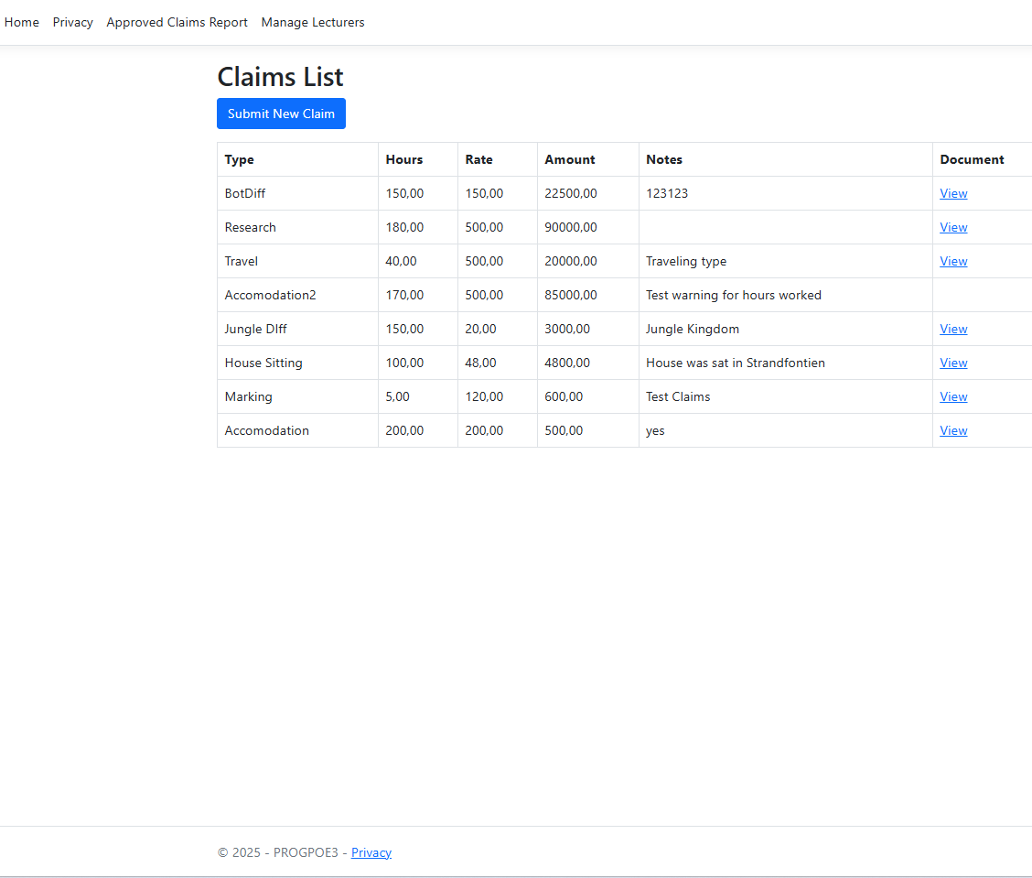
The index page
The index page shows all the claims made, also providing all the information. You are also able to view the documents

Slide 5
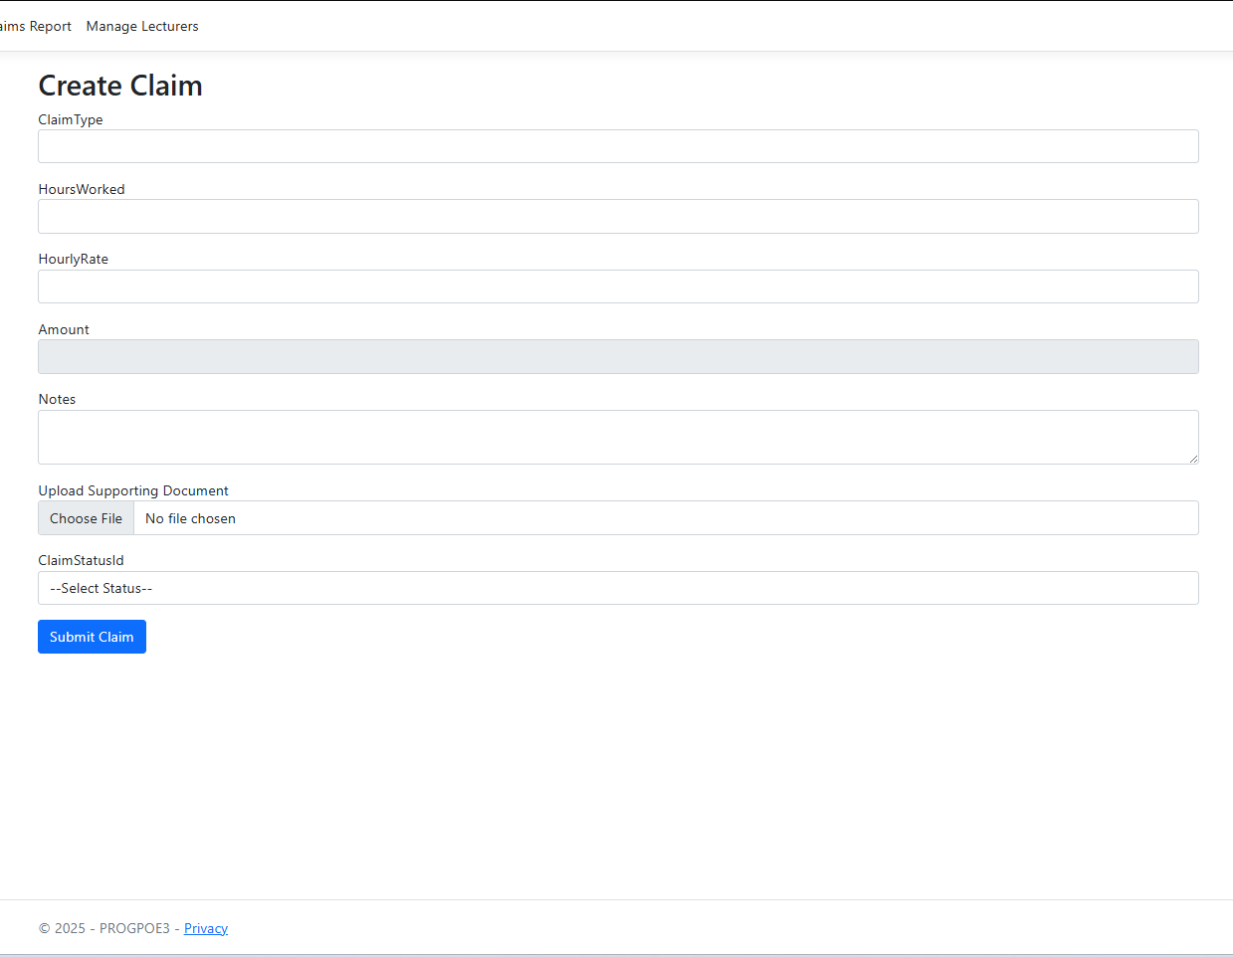
Lecturer "Submit Claim" form
Lecturers can submit claims by entering their hours worked, hourly rate, and any supporting notes.
This form uses MVC model binding and Entity Framework to store claims in the database.

Slide 6
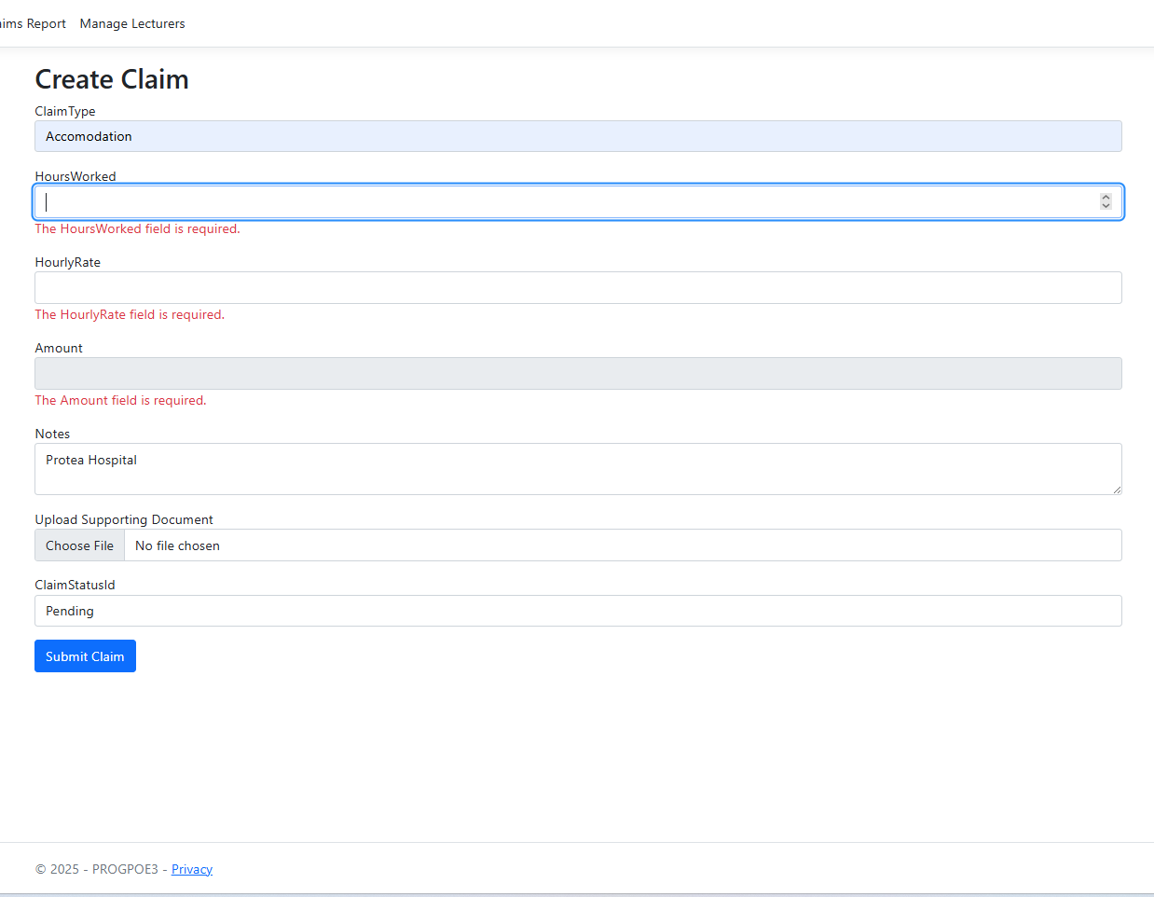
Claims Validation
Validation has been implemented to ensure that all entered information is accurate and does not break the system. This helps maintain clean, consistent, and reliable records throughout the application.

Slide 7
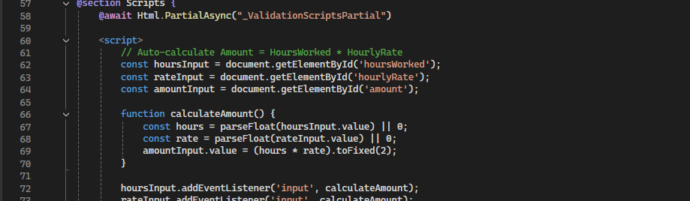
Automation: Auto-Calculation
To streamline the claim submission process and reduce human error, automation is implemented using JavaScript (jQuery). When the lecturer enters their Hours Worked and Hourly Rate, the system automatically calculates the total amount payable using the formula:
Amount = Hours Worked × Hourly Rate
This removes the need for manual calculations, making the process faster, more accurate, and more user-friendly.
A demonstration of this automation is shown in Slide 4, where the Claims Index page displays the correctly calculated amounts generated by the system.

Slide 8
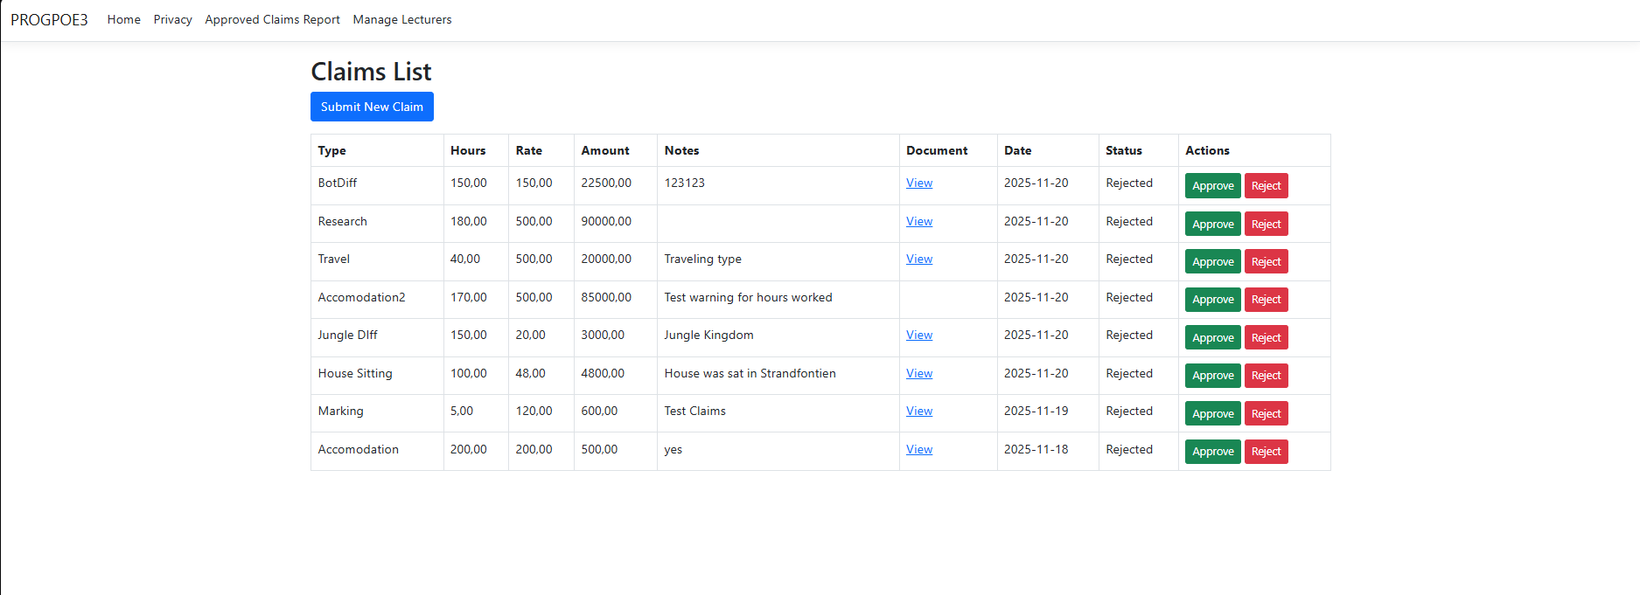
The Programme Coordinator and Academic manager view
The Programme Coordinator and Academic Manager interfaces share a similar layout and workflow to the Lecturer view; however, they include additional administrative functions designed to support the verification and approval process. In this view, both the PC and AM are able to review submitted claims, approve or reject claims, and maintain oversight of lecturer activities.

Slide 9
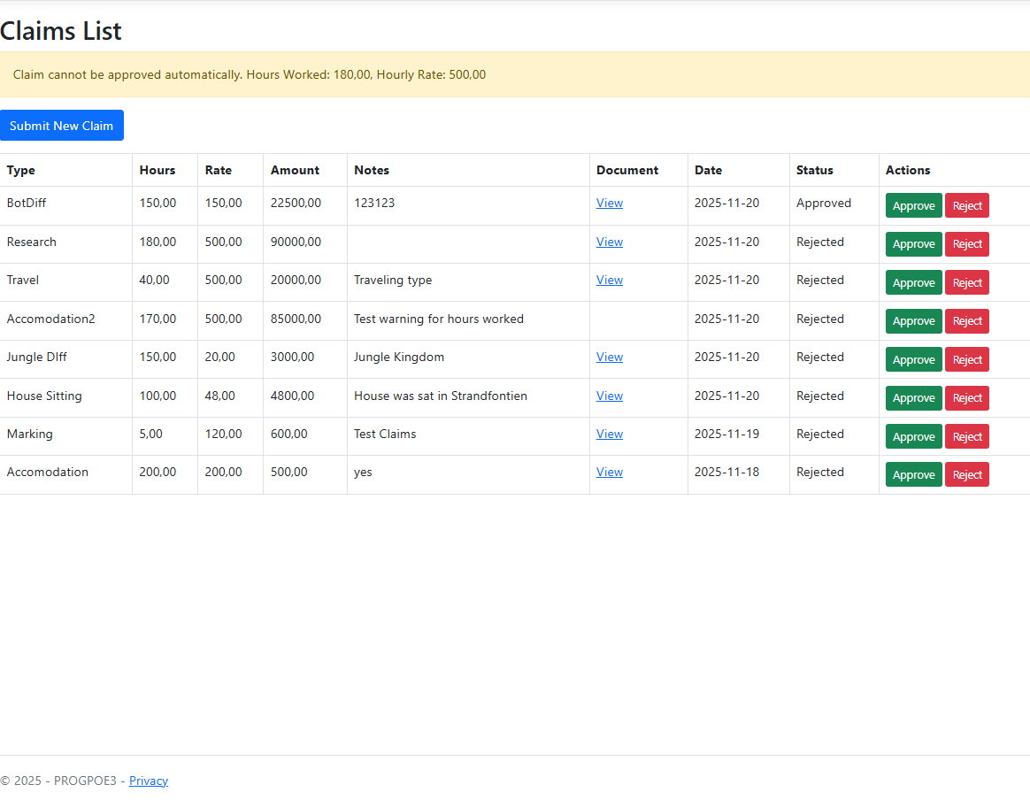
High-Value Claim Alert – Ensuring Accuracy & Security
This alert appears when a claim has an unusually high number of hours or amount. It ensures accuracy by prompting manual review, prevents potential errors or overpayments, and safeguards against accidental or fraudulent claims. By flagging such claims, the system helps maintain reliable and trustworthy claim processing.

Slide 10
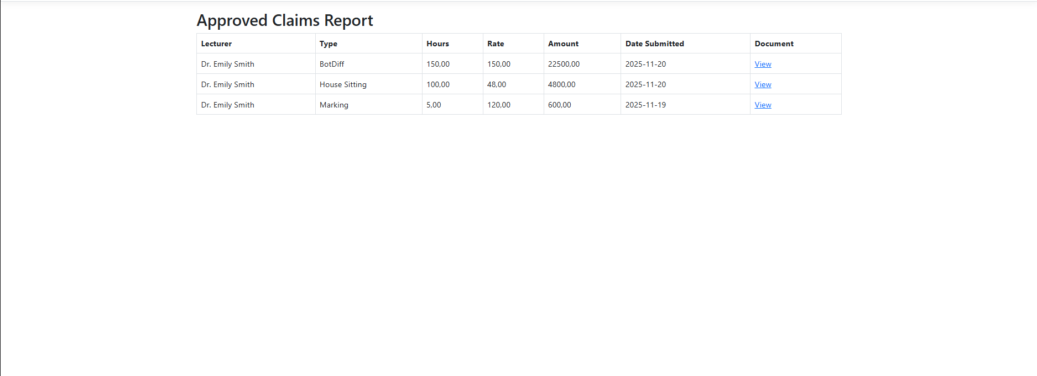
Approved claims report

Slide 11
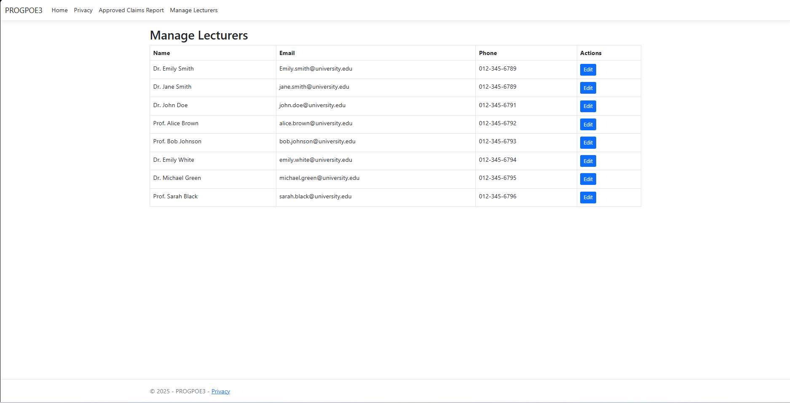
Lecturer Data Management
The system allows HR staff to efficiently manage lecturer information, including updating personal details, contact information, and employment data. By automating these administrative tasks, the platform reduces manual effort, ensures data accuracy, and streamlines overall HR processes.

